Slide 1

Computer Programming Internship Project Presentation
By Erik Garrow
June 26 2020

Slide 2
The Web Interface
I chose to do a relatively simple build to show the projects; title, description, and an image of the project.
I chose the colors and backdrop so they both would contrast and emphasize visibility while giving it a bit of a stylized look.
For the Interface, I did nothing fancy, just used the in-built scroller to navigate the one page I made and used

Slide 3
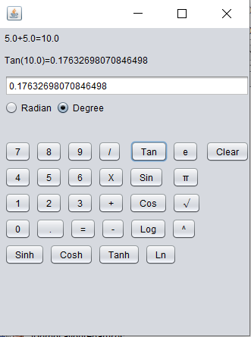
Calculator Project
Made using Java in the Netbeans Tool

Slide 4
Calculator Project Code
The buttons are coded to add to both the display section and to add to under the hood variables that are used for the actual calculations
I used if statements to choose the operation the code would calculate depending on the operator value which is assigned when an operation indicator is entered

Slide 5
Calculator Project
To avoid confusion and errors, I prevented the user from inputting characters into the input through the keyboard.
Since I did not know how to make the calculator follow the order of operations, it was coded to not be able to have multiple operations to calculate at once to prevent that problem from appearing
To try and compensate, it was coded so you could chain operations with relative ease

Slide 6
Calculator Project Interface
The numbers and basic operations are set like other calculators I saw
The radian and degree buttons was put close to where I saw it on other calculators

Slide 7
Calculator Project Operations
I added the radian and degree buttons in a group so some of the operations would be able to work properly
Pi and e were coded to function like numbers, since they had assigned values

Slide 8
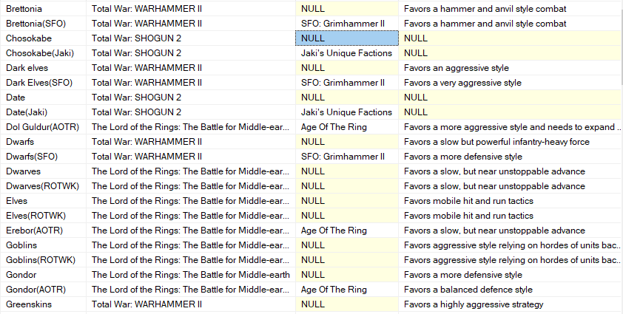
Video Game Faction Data Table
Made using Microsoft SQL Server

Slide 9
Video Game Faction Data Table notes
Chose to do this to show understanding of SQL and because I am interested in games
Gathered data to display largely by utilizing the internet to find information.
Used SQL server to set up and put data into the tables directly

Slide 10
Video Game Faction Data
The mod table contains information on the mods
The game table holds information on the games
The faction table holds information on the factions

Slide 11
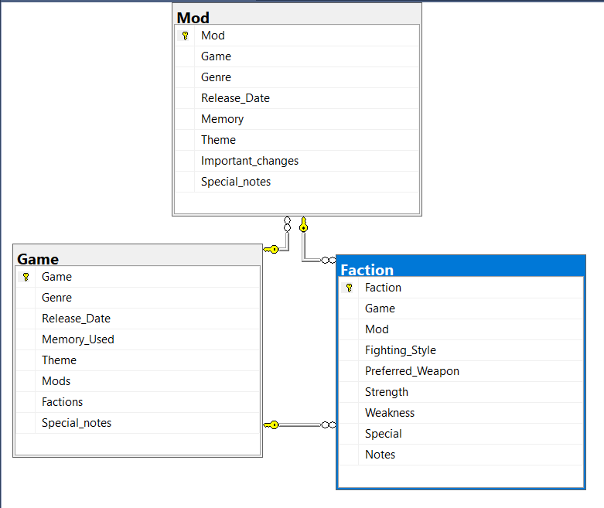
Video Game Faction Data Table Relationships
The Tables are linked together through variables of the same name

Slide 12
Video Game Faction Data Table Contents
Game Table holds the release date, name, memory usage, theme, mods, factions in the game, and potentially some notes on the game
Mod Table holds the name, the game it is for, release date, memory, theme, and some notes
Faction table holds data on the faction, favored style, strengths and weaknesses, favored weapon if applicable, along with the Game and mod( if applicable) the faction is in.

Slide 13
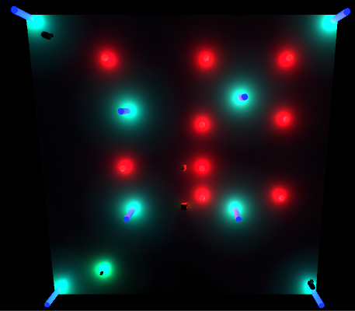
Wizard Wars Game
Made on Unity using C# code

Slide 14
Wizard Wars Code
Chose to make a video game using C# and Unity to both show I understand at least the basics of the tools, and also I admittedly am interested in making video games
Used a lot of if statements
Used the audio mixer tool in unity to help build a volume controller that will affect all parts of the game

Slide 15
Wizard Wars Movement
Used a framework that was online for basic movement
Built a shoot button that fires projectiles the direction the player is facing
Built the code so the different projectiles will act differently

Slide 16
Wizard Wars Single Player
Built to allow players to play the game solo and get some practice
Used launchers coded to launch projectiles that get destroyed on hit as enemies
Coded gates that lock later areas until current enemies are defeated, and more projectile types are added to enemies in later areas
End screen changes depending on progress through the mode

Slide 17
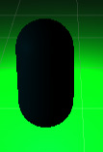
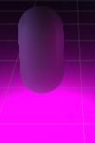
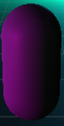

Wizard Wars Power-Ups
Coded to disappear on collision with a player character
When a player character collides with one, it either activates an effect or ticks one of the projectile type numbers up, which tick down when one is fired by the player.

Slide 18
Wizard Wars Gameplay
Inspired by steam game Invisigun
Mainly a Two Player game, built to rely on effective usage of light, or of the lack thereof.
Powerups are randomly spawned to keep things a bit more interesting
Uses one fixed top-down camera in 2-player mode to help catch the feel of the game that I was aiming for

Slide 19
Reflection Calculator Project
I could have put more effort and testing towards making sure that the calculator had a decent button layout
I could have decreased the amount of code needed by creating a set of code that can be called to do the calculations instead of copying the code to each point where it would need to be used

Slide 20
Reflection Video Game Faction Data Table
Might have worked better if I was more selective on the data to enter the table for the factions, since some of the columns seem not that helpful and tends to not have data
Probably should have made a number column and use that as the primary key for the faction table

Slide 21
Reflection Wizard Wars
In hindsight, I should have put more work on compartmentalized code, making interlocked sets of code instead of some of the long code files I made
Should have probably used more functions besides stuff like update provided by unity

Slide 22
Works Cited
French, J. L. (2020, May 27). The right way to make a volume slider in Unity (using logarithmic conversion). Retrieved June 25, 2020, from https://gamedevbeginner.com/the-right-way-to-make-a-volume-slider-in-unity-using-logarithmic-conversion/
Tiercelin, N. (2017, August 7). Unity: CHARACTER CONTROLLER vs RIGIDBODY. Retrieved June 25, 2020, from https://www.gamasutra.com/blogs/NielsTiercelin/20170807/303170/Unity_CHARACTER_CONTROLLER_vs_RIGIDBODY.php

